Slide 1
Statistical language learning
Prof. Nuria Sagarra
This presentation is based on Jenny Saffran’s work.

Slide 2
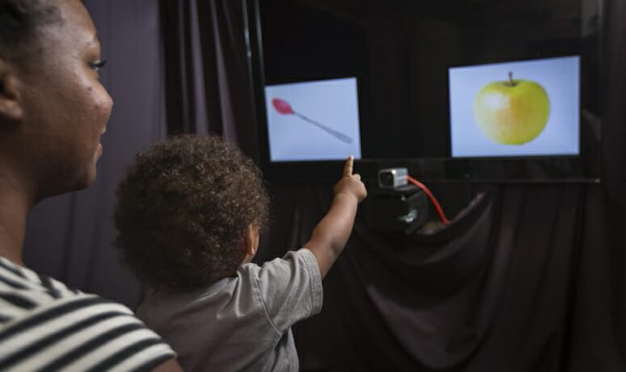
You know more than you think…
You know when words begin and end when you listen to me.
You know the dog bit the boy is different from the boy bit the dog.
You know dog the man the bit is ungrammatical (but it’s grammatical in Japanese)
How does all this information get into a baby’s head?
We can address this question by examining
where babies look while they’re listening to things.
Notes:
AFTER FIRST BULLET: As you listen to me speak, you understand my words and you KNOW when my words begin and end, even though I (pause) don’t (pause) talk (pause) like (pause) this (pause). Like the white spaces between words you see when you read. But there’s no little white spaces in the auditory world. Also, if you hear the dog bit the boy, you KNOW it means sth different from the boy bit the dog, even though ti’s the same words. And you KNOW that dog the man the bit is ungrammatical in English, although it is grammatical in Japanese. So the question is: how do we learn all this information?

Slide 3
Babies produce their first word when they are about 1yr old.
BUT what babies say underestimates their linguistic knowledge.
Language learning occurs even before birth, so researchers like Jenny Saffran (University of Wisconsin at Madison) want to know what happens up to the first year of life.

Slide 4
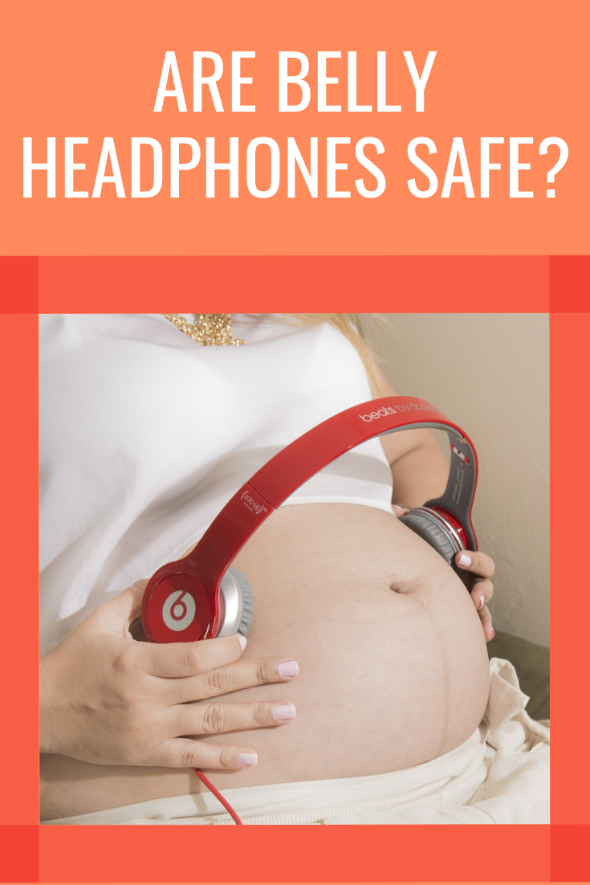
Language development (aka becoming a native speaker)
LATE FETAL PERIOD
3rd trimester of pregnancy, babies’ heart beats faster when they hear their mom’s voice than other people’s voices.
One can claim that this is because their mom’s voice is the loudest, but their mom’s digestive system is actually louder than their mom’s voice.

Slide 5
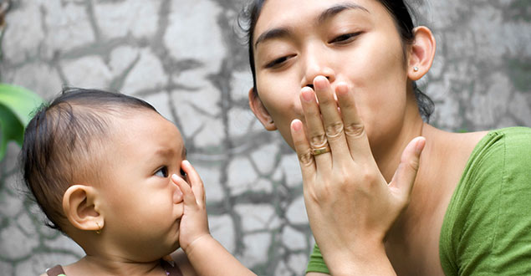
Language development (aka becoming a native speaker)
6-8 months:
Vowels adapted to native language
Discover word boundaries in fluent speech
“Understand” highly frequent words
Bergelson & Swingley (2012)

Slide 6
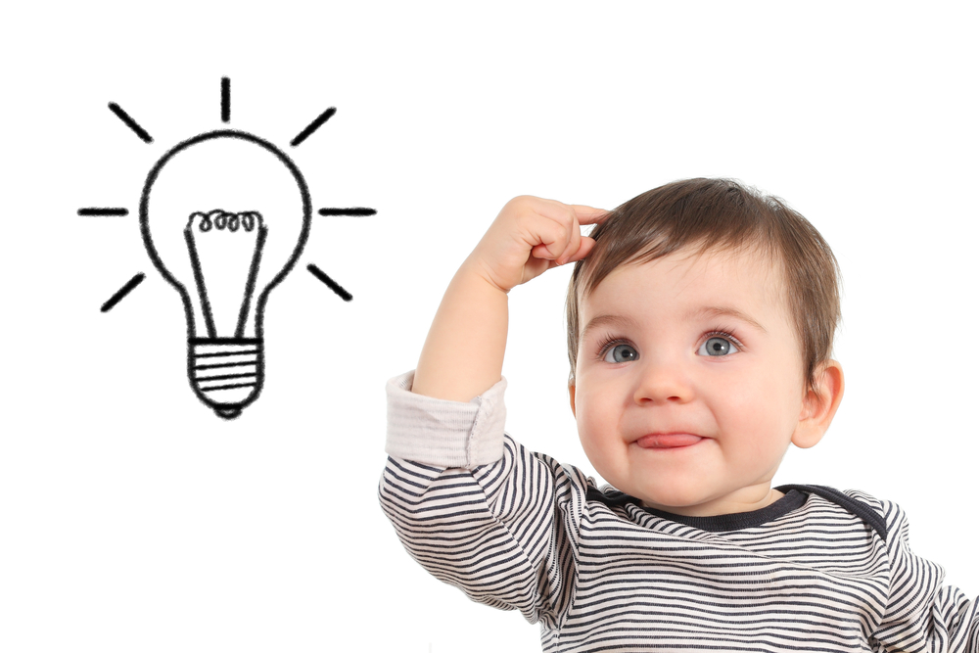
Language development (aka becoming a native speaker)
8-12 months:
Consonants adapted to native language (Japanese babies unable to differentiate RA from LA)
Remember words over a 2 week delay
Notes:
So a Japanese baby will no longer be able to distinguish between RA and LA but an English baby will.

Slide 7
All of this happens before we even produce our first word!
So… how do we learn our native language?

Slide 8
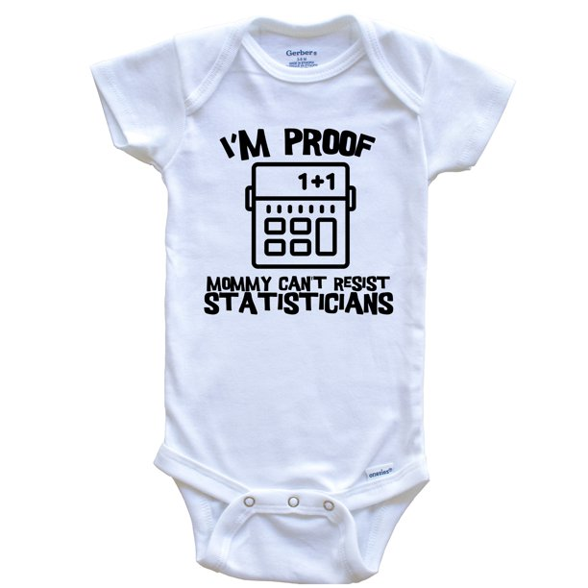
Languages are filled with statistical patterns…
Think about the sounds of speech, the music of speech, boundaries between words, meaning of words, morphemes, syntactic rules (e.g., word order)…
Babies are like statisticians. Their brains are very sensitive to probabilities based on frequencies.

Slide 9
Languages are filled with statistical patterns…
Think about the sounds of speech, the music of speech, boundaries between words, meaning of words, morphemes, syntactic rules (e.g., word order)…
Babies are like statisticians. Their brains are very sensitive to probabilities based on frequencies.

Slide 10
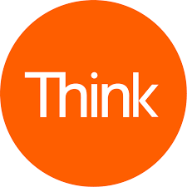
The music of speech varies from language to language.
PAROXYTONE: stress on first syllable: ORder
OXYTONE: stress on last syllable: coRRECT
Circle the stressed syllable of each English word. Are English di-syllabic words mostly oxytone or paroxytone?
Google the translation of these English words into French. Write down the French words and circle the stress syllable of each word. Are French di-syllabic words mostly oxytone or paroxytone?
English | cookie | baby | mommy | coffee
French
Notes:
Babies are like statisticians. Their brains are very sensitive to probabilities based on frequencies.
Music of speech: this varies from lang to lang: a 2-syllable word in Engilsh is normally a stress-no stress pattern: Baby, BOOkie, Mommy, coffee. Now compare with French: beBE, bisCUIT, maMAN, café. Over 90% of the words we speak to babies in English and in French have this pattern (paroxytone or oxytone).

Slide 11
Languages are filled with statistical patterns…
Think about the sounds of speech, the music of speech, boundaries between words, meaning of words, morphemes, syntactic rules (e.g., word order)…
Babies are like statisticians. Their brains are very sensitive to probabilities based on frequencies.

Slide 12
https://www.netflix.com/watch/80117843?trackId=14277283&tctx=-97%2C-97%2C%2C%2C%2C
(9:06-12:27)
Notes:
Babies are like statisticians. Their brains are very sensitive to probabilities based on frequencies.
Music of speech: this varies from lang to lang: a 2-syllable word in Engilsh is normally a stress-no stress pattern: Baby, BOOkie, Mommy, Daddy. Now compare with French: beBE, bisCUIT, maMAN,

Slide 13
More about boundaries between words
Imagine you are a baby and you hear ”pretty baby”. How do you know these are 2 words and not 1 word (prettybaby) or 4 words (pre tty ba by)?
Notes:
Babies are like statisticians. Their brains are very sensitive to probabilities based on frequencies.
Music of speech: this varies from lang to lang: a 2-syllable word in Engilsh is normally a stress-no stress pattern: Baby, BOOkie, Mommy, Daddy. Now compare with French: beBE, bisCUIT, maMAN,

Slide 14
How do we know whether babies can track statistical regularities?
Saffran, Newport & Aslin (1996):
8-month olds listened to an artificial language for 2 min:
tokibugikobagopilatipolutokibugopilatipolutokibugikobagopilagikobagopilagikobatokibugopilatipolugikobatipolu
Can you divide this speech stream into words?
Do you see any IF-THEN patterns?

Slide 15
How do we know whether babies can track statistical regularities?
Saffran, Newport & Aslin (1996):
8-month olds listened to an artificial language for 2 min:
Tokibugikobagopilatipolutokibugopilatipolutokibugikobagopilagikobagopilagikobatokibugopilatipolugikobatipolu
https://www.netflix.com/watch/80117843?trackId=14277283&tctx=-97%2C-97%2C%2C%2C%2C
(23:38-27:50)
Notes:
TOKIBU,GIKOBA,GOILA, TIPOLU, TOKIBU, GOPILA, TIPOLU, TOKIBU, BI

Slide 16
Can babies track statistic regularities in non-linguistic input? Think of melodies, actions, social cues.
What about monkeys?
What about rats?
Notes:
TOKIBU,GIKOBA,GOILA, TIPOLU, TOKIBU, GOPILA, TIPOLU, TOKIBU, BI

Slide 17
How do bilingual babies track statistical regularities?
They must figure out that the input is coming from two languages and they must track language input separately for each language.
Studies examining statistical learning in bilinguals have focused on 2 goals:
To identify whether bilinguals differ from monolinguals in how they track distributional regularities
To determine how learners are capable of tracking multiple inputs, an ability important in becoming proficient in more than one language.
To read a summary of studies on the topic, read:
Weiss, Schwob, & Lebkuecher (2020). Bilingualism and statistical learning: Lessons from studies using artificial languages. Bilingualism: Language and Cognition.

Slide 18
How do bilingual babies track statistical regularities?
They must figure out that the input is coming from two languages and they must track language input separately for each language.
Studies examining statistical learning in bilinguals have focused on 2 goals:
To identify whether bilinguals differ from monolinguals in how they track distributional regularities
To determine how learners are capable of tracking multiple inputs, an ability important in becoming proficient in more than one language.

Slide 19
In conclusion
We know much more than we think we know about languages.
We start learning languages before being born.
Some researchers believe that we learn languages using mathematical statistical computations in our brain to notice patterns in the input.

